Slide 1
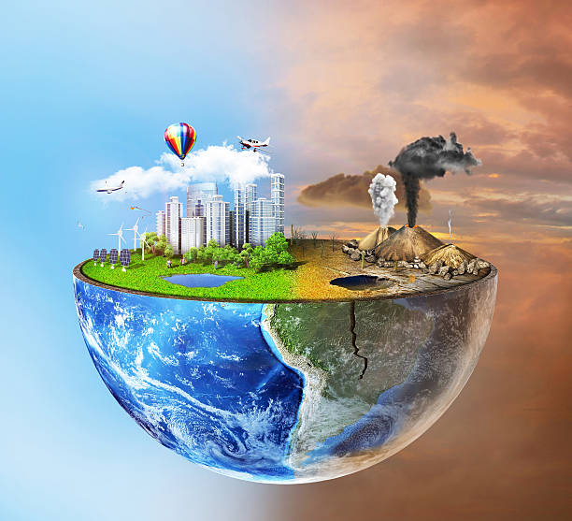
Environment pollution
Presented By
Afsana Haque Nusrat
Registration No: 2019236019

Slide 2
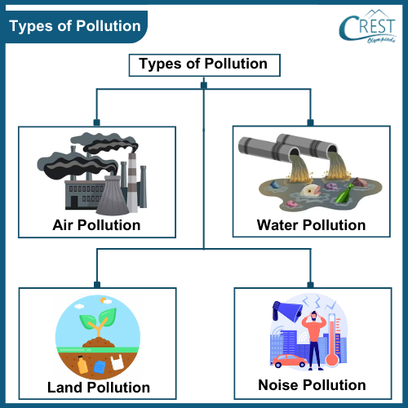
What is Environmental Pollution?
Definition: Environmental pollution refers to the contamination of the natural environment by substances harmful to living organisms.
Types of Pollution:
Air Pollution
Water Pollution
Soil Pollution
Noise Pollution
Light Pollution
Visual: Infographic illustrating different types of pollution

Slide 3
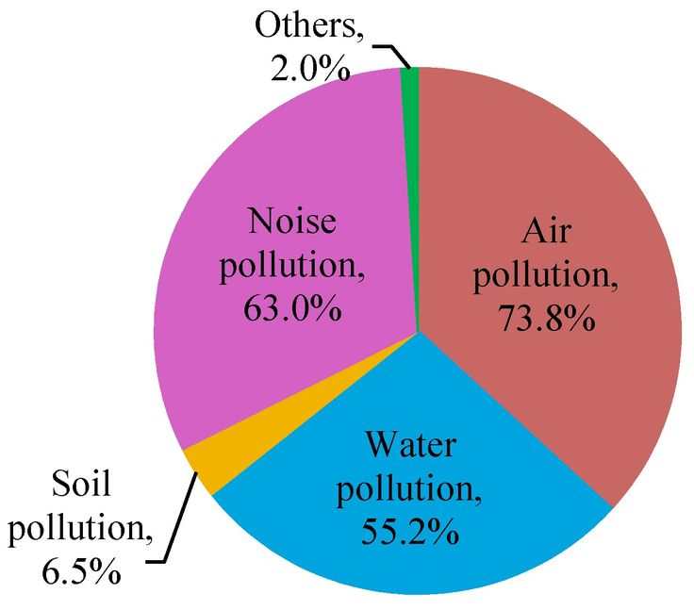
Causes of Pollution
Air Pollution:
Vehicle emissions, industrial smoke, deforestation
Water Pollution:
Industrial waste, plastic disposal, oil spills
Soil Pollution:
Use of pesticides, improper waste disposal
Noise Pollution:
Urban development, traffic, industrial activities
Visual: Pie chart showing percentage contribution of various sources

Slide 4
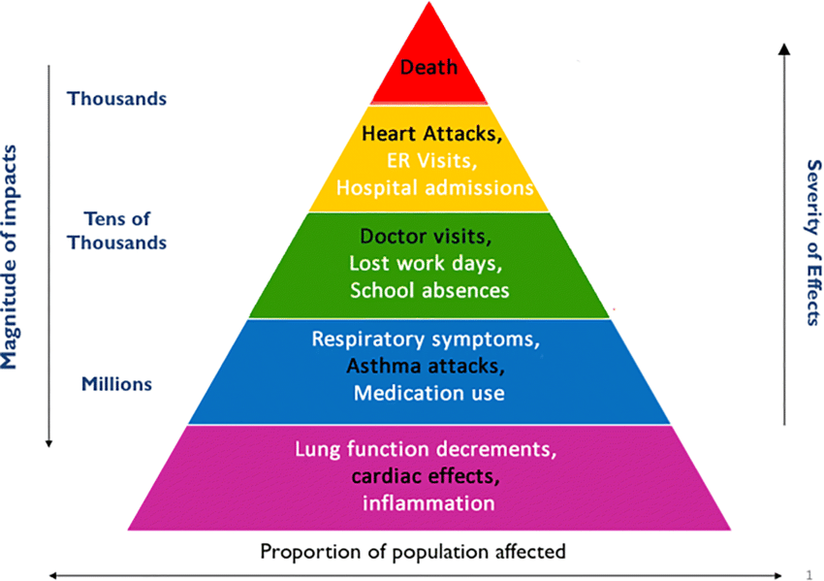
Effects of Pollution
Health Effects:
Respiratory diseases, waterborne diseases, mental stress
Environmental Impact:
Global warming, acid rain, loss of biodiversity
Economic Impact:
Damage to crops, increased healthcare costs, loss of tourism
Visual: Diagram linking pollution types to their effects

Slide 5
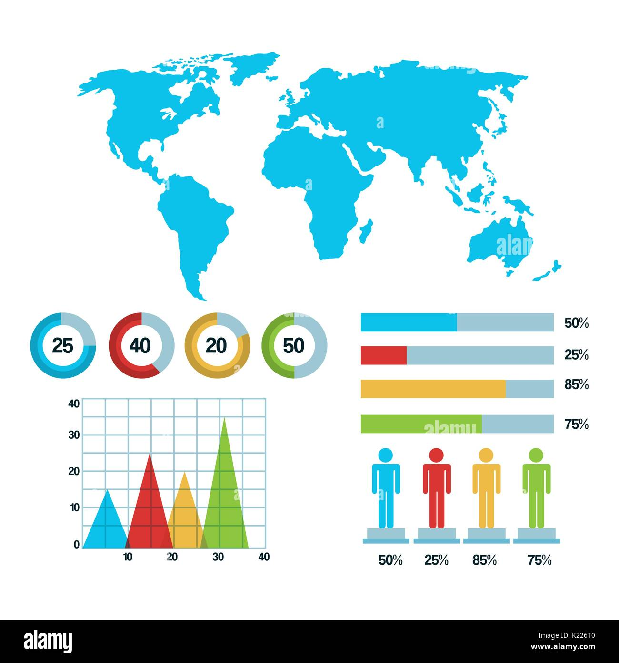
Global Statistics
Air Pollution: Responsible for 7 million deaths annually (WHO).
Water Pollution: 80% of wastewater is untreated worldwide (UNESCO).
Plastic Waste: 8 million tons of plastic enter oceans annually (UNEP).
Visual: Bar graph or world map highlighting key statistics

Slide 6
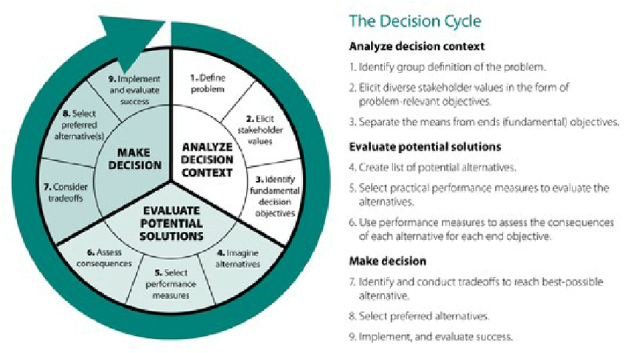
Solutions to Reduce Pollution
Individual Actions:
Reduce, Reuse, Recycle
Use public transport, conserve water, plant trees
Community Efforts:
Promote awareness, community clean-ups
Government Policies:
Stricter regulations, renewable energy investments
Technology Innovations:
Green tech, waste-to-energy systems
Visual: Checklist or cycle diagram

Slide 7

Call to Action
Key Message: Let’s work together to protect our planet!
What You Can Do:
Take small daily steps to reduce your carbon footprint.
Spread awareness within your community.
Visual: Inspiring image of people participating in an environmental initiative

Slide 8
Thank You

